Slide 1
Where are the WholEUGrain countries in establishing their own partnerships?
Experience of the Republic of Srpska
WholEUGrain Spring School Conference, 29th March 2022
Stela Stojisavljević, MD PhD, on behalf of the PHI RS Project Team
Institute of Public Health of the Republic of Srpska (PHI RS)

Slide 2
Prevention of NCDs in the RS
Action Plan for the prevention of NCDs in the RS
MoHSW RS and PHI RS – main actors in the field of the public health
Local self-governmnet units responsible at the local level
Priority interventions at the population level:
Promotion of the Whole Grain Production and Use
Promoting healthy consumption through fiscal and marketing policies
Promotion of the Whole Grain Production and Use
Reformulation and improvement of products: salt, fats and sugars
PPP

Slide 3
So far activites
Project Team established within PHI RS
Exchange of information with other project partners, MoH RS, Chamber of Commerce and other relevaqnt stakeholders in the
Literature and legal documents related to WG production and distribution studied
Relevant stakeholders have been identified from public and private sector
The meeting with stakeholders held in December 2021
Promotion of WG in pre-school and school environment
Preparation for Spring school
ADMINISTRATIVE CHALLANGES!

Slide 4
The meeting with stakeholders in December 2021
Public and Academic | Private | Civil Society
Public Health Institute of the Republic of Srpska | Krajina Klas – bakery industry | Association of consumer protection
Ministry of Economic Affairs and International Cooperation in the Government of the Republic of Srpska | Žitoprodukt – bakery industry
Chamber of Commerce of the Republic of Srpska | Semberija – milling industry
University Clinical Center of the Republic of Srpska
University of Banja Luka, Agricultural Faculty
Republic Administration for Inspection Activities
RS Agricultural Institute

Slide 5
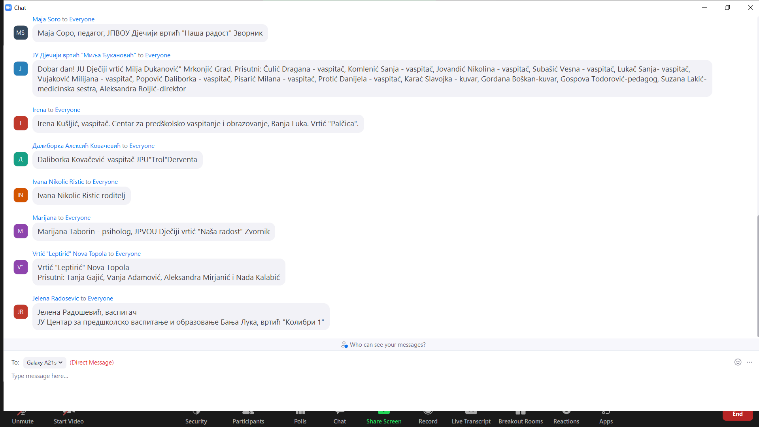
Link to other activities/projects
Promotion of Whole Grain intake in pre-schools and schools – PUPPI project (UNICEF)
https://vimeo.com/678067460/a69ba6b3fd
Organized eductation for children, teachers and pаrents

Slide 6
Challanges!
Administrative procedures
Short time for the implementation of the project
Public stakeholders need a long period of time to recognize their role in WG project
Limited commercial interest in the population health

Slide 7
Thanks for your attention!
stela.blk@gmail.com
stela.stojisavljevic@phi.rs.ba
More about the project: https://www.gzs.si/wholeugrain

